Slide 1


CHCCCS040
Support independence and wellbeing (Release 1)

Slide 2
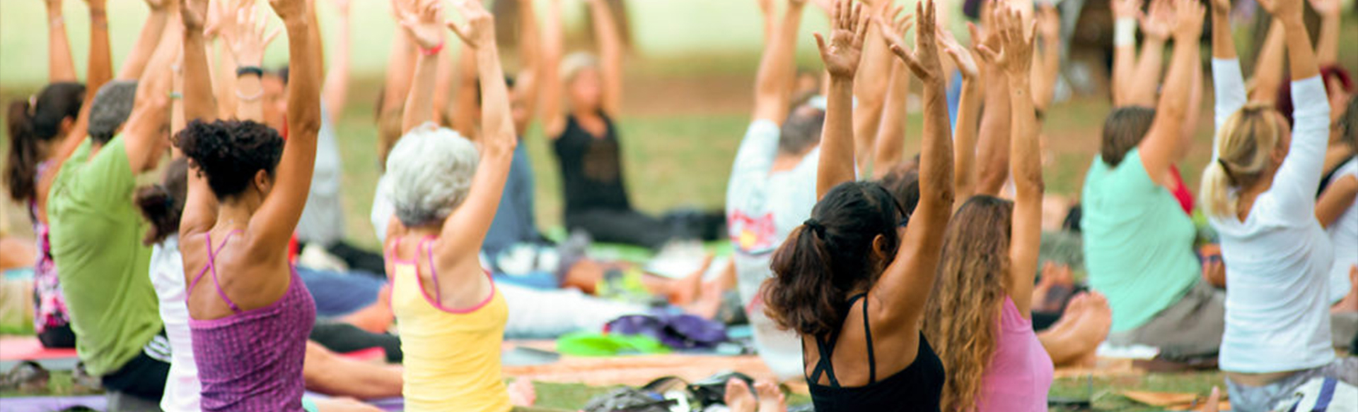
About this Unit of Competency
CHCCCS040 - Support independence and wellbeing (Release 1)
This unit describes the skills and knowledge required to provide individualised services in ways that support independence, as well as physical and emotional wellbeing.

Slide 3

This unit applies to workers in a range of community services contexts who provide frontline support services within the context of an established individualised plan.
The skills in this unit must be applied in accordance with Commonwealth and State/Territory legislation, Australian/New Zealand standards and industry codes of practice.

Slide 4

Presentation Objectives
At the end of this session, you will be able to:
Recognise and support individual differences
Promote independence
Support physical wellbeing
Support social, emotional and psychological wellbeing

Slide 5
Introduction
This unit explores the concept of how to support a person’s independence and wellbeing.
Two critical points to consider for this concept:
Interpersonal skills – How you communicate and interact
Emotional intelligence – Your ability to read and control emotions
You will use these skills to recognise the unique needs of a person and support them in ways that align with their needs, goals and preferences.

Slide 6
You may support a diverse set of people including, but not limited to the following:
Older people
People with disability
People with health conditions
Individuals living in the community
Individuals living in residential care environments
Other prospective individuals to the service or services

Slide 7

You may work in the environments such as the following:
Community centres
Employment services
Person’s own dwelling
Residential aged care facilities
Independent living accommodation

Slide 8
Support work comes with a lot of considerations.
Foremost of these considerations are of legal and ethical in nature.
These considerations help ensure the person’s safety and dignity.
You will learn these considerations first.

Slide 9

Legal and Ethical Considerations
Legal considerations are things that you must do or follow according to written laws.
Ethical considerations are what you do following human beliefs of right and wrong.
Most legal considerations come from ethical considerations.

Slide 10
You may use the word obligation in place of consideration.
The word obligation only emphasises that everyone must follow the consideration.
In your work, legal and ethical considerations go together.
You do things because they are the right ones to do and the law requires you to do them.

Slide 11
Organisational Policies and Procedures
Policies and procedures ensure that organisations apply all legal and ethical considerations.
Policies describe what an organisation does and why they do it.
An organisation’s policies are the principles that influence all decisions made.
Procedures are the actions and processes that make the policies possible.

Slide 12
You must be familiar with your organisation’s policies and procedures that should at least cover the following considerations:
Duty of care
Dignity of risk
Human rights
Privacy, confidentiality and disclosure
Work role boundaries
Discrimination
Mandatory reporting
Restrictive practices

Slide 13
Duty of Care
It is a legal obligation:
That requires workers to always act in the person’s best interests
With ethical origins
You must always prevent the person from experiencing any form of harm that can be but is not limited to physical, emotional, and mental damage.

Slide 14
A breach of duty of care happens when the person experiences harm during your work with them.
Some of the best practices to promote duty of care include those listed below:
Maintaining people’s privacy
Preventing abuse and neglect
Providing safe and high-quality service
Helping people maintain independence
Treating people with dignity and respect

Slide 15

Some of the best practices to promote duty of care include those listed below:
Giving people control over their decisions
Listening to people’s opinions and feedback
Immediately reporting hazards in the workplace
Eliminating or minimizing risks within the scope of one’s role and responsibilities

Slide 16
Dignity of Risk
The concept says that:
A person has the right to choose what they want to do
The person also recognises that their choices come with possible dangers
In your work, it is your responsibility to:
Respect the person’s dignity of risk
Help minimise the risk involved with the person’s choices
Refer to your organisation’s policies and procedures about the dignity of risk

Slide 17
The following best practices may help in minimising possible risks the person might get involved in:
Listen to the person.
Explain the risks associated with the activities that the person wants to join.
Do your part in mitigating the risks that may affect the person.
Plan on how you will document the person’s participation in the activity.

Slide 18

Human Rights
These are standards that recognise and safeguard the dignity of all humans.
Every individual:
Has human rights
Must respect others based on their human rights.
Human rights have always been part of different legislations that aim to protect the rights of everyone.

Slide 19
Necessary rights for everyone include the following:
Right to healthcare
Freedom from discrimination
Right to information
Right to autonomy
Right to participation

Slide 20

Privacy, Confidentiality and Disclosure
Privacy ensures every person can keep their information to themselves. It also:
Gives every person the choice of who can interact with them and what others can know about them
Ensures that every person can set boundaries that match their preferences
Is a right that you must recognise and respect

Slide 21
Confidentiality is the responsibility to keep a person’s information private and safe from unauthorised access.
Disclosure is the act of sharing or revealing information.
The Privacy Act 1988 is a national law that protects people’s private information.
It contains the 13 Australian Privacy Principles that applies to Australians of all ages.
The Act includes special cases where disclosure of private information is acceptable.
These special cases cover health services.

Slide 22
According to Division 2, part 16B of the Act, exceptions include situations where:
Information is necessary to provide medical care
Information is necessary to keep the person safe
A representative has given consent, if person is unable
Information may affect public health and safety

Slide 23
Below are some of the best practices to maintain privacy and confidentiality.:
You must get permission before collecting any information from the person.
You must inform the person how you will manage and secure their information.
You must be careful where you leave the person’s records. Do not leave them unattended or in public areas.
Make sure to explain the purpose of collecting information from the person.

Slide 24
Work-Role Boundaries
They define your exact responsibilities when supporting the person.
They limit what the person can ask from you and restrict you from going beyond your duty and responsibility.
Setting clear boundaries has the following benefits:
You can provide effective and goal-directed service.
You can avoid receiving excessive or unnecessary demands.
You can secure your own information and that of the person.

Slide 25

Setting clear boundaries has the following benefits:
You can prevent the person from showing inappropriate behaviour.
You can avoid having to balance personal and professional relationships at work.
You will maintain professionalism when interacting with and caring for the person.

Slide 26
Work-role boundaries are fundamentally ethical in nature.
They are inherent in any service work.
Your organisation may have more detailed policies and procedures.
Separating personal relationships from work is the right thing to do.
Other benefits of work-role boundaries:
They ensure that the service you deliver is only based on your defined role.
They protect you from many liabilities (as a legal consideration).

Slide 27
The following best practices can help establish an effective work-role boundary:
Maintain a professional relationship with the person.
Do not disclose information about the person to other people.
Limit the services you provide according to your job description.
Do not discuss personal or sensitive information with the person.
Do not take advantage of your person’s kindness by asking for items and other favours.

Slide 28
Restrictive Practices
These are any processes or interventions that limits rights or freedom.
Organisations and institutions use restrictive practices on people displaying behaviours of concern.
Restrictive Practices try to stop or slow down behaviours that may cause harm to the person or others.

Slide 29
Common types of restrictive practices include the following:
Chemical restraint
Environmental restraint
Mechanical restraint
Physical restraint
Seclusion

Slide 30
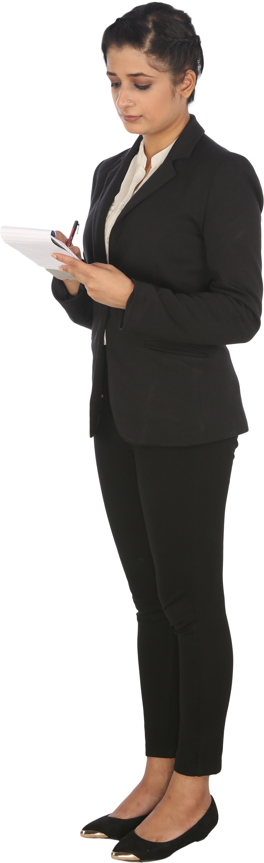
In Australia, care workers can use authorised restrictive practices.
But one only uses it as a last resort and in its least restrictive form.
A care worker should use it to prevent or protect a person from others from harm.

Slide 31
Authorised use of restrictive practices must reflect the organisational policies and procedures:
The person must post plausible harm to themselves or others.
Chemical restraints need assessments from medical or nurse practitioners.
Workers must use all the best possible alternative behaviour support strategies beforehand.
Workers will only use restrictive practices proportional to the risk of harm.

Slide 32
Authorised use of restrictive practices must reflect the organisational policies and procedures:
Organisations must continuously monitor, review and document:
The use of restrictive practices
The need for restrictive practices
The effectiveness of restrictive practices
Workers must be aware of when to reduce or stop the use of restrictive practices.
There must be informed consent to use a restrictive practice from the person.

Slide 33

Authorised use of restrictive practices must reflect the organisational policies and procedures:
The use of restrictive practices must adhere to the following applicable requirements:
Aged Care Quality Standards
The Charter of Aged Care Rights
National Standards for Disability Services (NDIS)

Slide 34
Authorised use of restrictive practices must reflect the organisational policies and procedures:
The use of restrictive practices must adhere to the following applicable requirements:
The applicable regulation of the State or Territory of practice
Any relevant provisions of the person's care or behaviour support plan

Slide 35
Consider the following implemented policies and procedures that usually arise from disability and mental health laws:
Victoria, Queensland and Tasmania have restrictive practices regulations in their disability services laws.
Victoria and Queensland have detailed provisions and guidelines in their mental health laws.
Other States and Territories have yet to formalise their relevant laws.

Slide 36
Workers must have a behaviour support plan in place for every person who:
Exhibits behaviours of concern or change in behaviour
Has restrictive practices considered, applied or used as part of their care.
The behavioural support plan only forms part of the individual care plan and does not replace it.
It must set out information about the person that will help the care worker understand their background and changed behaviour.

Slide 37
This information about the person includes but is not limited to:
Any assessments which have been carried out about those behaviours
Known triggers which may precede those behaviours
Alternative strategies which are successful or unsuccessful in managing those behaviours
Any restrictive practices used or applied once alternative strategies have been tried

Slide 38
The behavioural support plan must include evidence of consent from the person.
There must also be ongoing documentation in place that will help inform other staff of continuing care.
The National Disability Insurance Scheme (NDIS) has guidelines on the care provider's obligations when using restrictive practices.

Slide 39
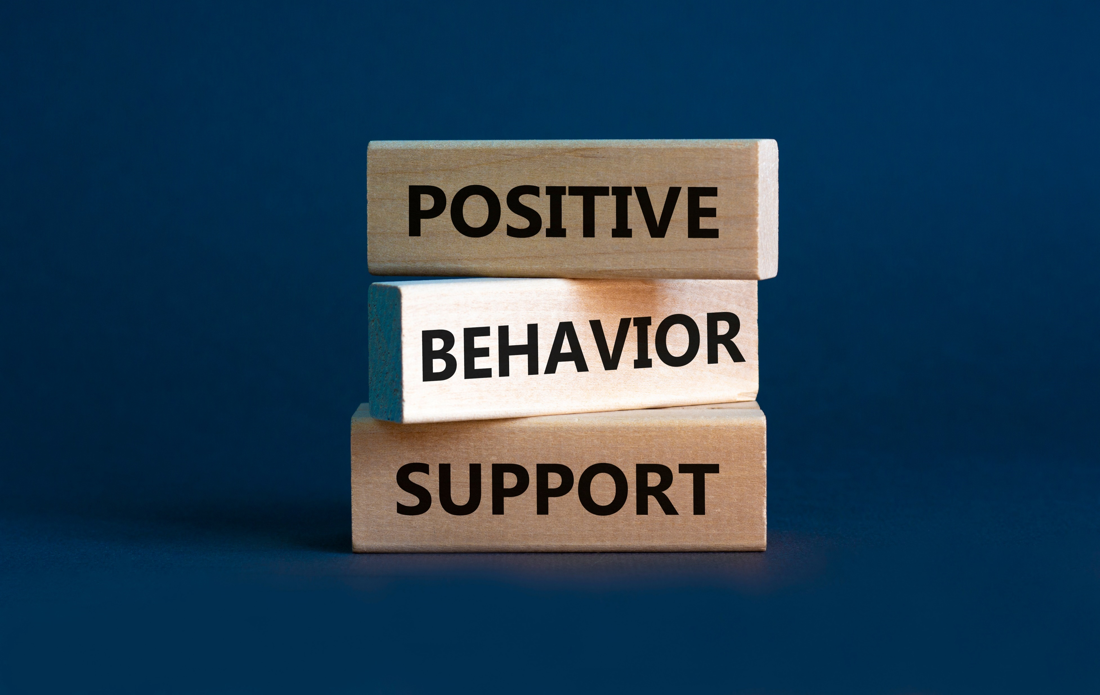
All providers using authorised restrictive practices must meet the following conditions of registration:
An NDIS behaviour support practitioner must have developed a behaviour support plan which makes the use of a restrictive practice possible.

Slide 40

All providers using authorised restrictive practices must meet the following conditions of registration:
When using a restrictive practice, it must:
Be the least restrictive response possible in the circumstances
Reduce the risk of harm to the person or others
Last for the shortest possible time to ensure the safety of the person or others

Slide 41
All providers using authorised restrictive practices must meet the following conditions of registration:
Where required, the implementing provider must have authorisation that will come from the State or Territory.
The implementing provider must follow monthly reporting requirements.

Slide 42
Alternative behaviour support strategies may be addressed as positive strategies for brevity.
Positive strategies include:
Individualised planning
Environmental changes
Strengths-based approach
Early assessment and intervention

Slide 43
Individualised Plans
An individualised plan addresses a person’s needs.
Characteristics of an individualised plan:
It has goals that correspond to the needs of a person.
Its actions taken are to address all needs that align with the person’s identity.
It follows a person-centred approach.

Slide 44
Self-awareness is essential in your role.
You must recognise:
That everyone has their values, opinions and experiences
The unique personal qualities people use to carry their day-to-day lives
You must always adjust for the person.

Slide 45
In your role, you will:
Have to promote the person’s independence
Enable them to practise self-care and self-management
Support their physical wellbeing
Have to identify and reduce risks around them
All these aim to establish their right to autonomy and maintain their safety and security.

Slide 46

Recognise And Support Individual Differences
CHCCCS040 – Support independence and wellbeing (Release 1)

Slide 47
No two people are genuinely the same.
Even siblings with the same upbringing will have differences that make them unique from each other.
Learn to recognise individual differences that include:
Characteristics
Behaviours
Experiences
Values of a person
Recognise And Support Individual Differences

Slide 48
The initial stage in supporting independence and wellbeing is through recognising and supporting individual differences.
In order to recognise and support individual differences, you must:
Recognise and respect the person’s social, cultural and spiritual differences
Avoid imposing views and support the person’s expression of identity and preferences
Recognise And Support Individual Differences

Slide 49
In order to recognise and support individual differences, you must:
Consider the individual needs, stage of life, development and strengths for support activities
Recognise, respect and accommodate the expression of identity and sexuality according to maturity
Promote and enable participation in activities that reflect the person’s individual needs
Recognise And Support Individual Differences

Slide 50

1.1 Recognise and Respect the Person’s Social, Cultural and Spiritual Differences

Slide 51
A society is an ordered collection of interacting populations.
Through order and interaction, a society advances in all aspects.
But because everyone is unique, a society will encounter many individual differences.
These individual differences are caused by many traits such as:
Capabilities
Experiences
Background
Spirituality/religion
Culture
Sexuality
Social interactions and activities
Recognise And Support Individual Differences

Slide 52
Individual differences based on traits are interrelated.
One trait may have a direct or indirect effect on one or more traits.
For instance, a person’s culture can affect other traits, such as the way a person communicates or expresses their sexuality.
It then is impossible to target one trait without affecting other personal traits.
Recognise And Support Individual Differences

Slide 53
Social Differences
They are concerned with how people interact with one another .
Social differences may involve variations in:
Educational background
Economic power and class
Relationships with the family
Personal preferences on gathering
Recognise And Support Individual Differences

Slide 54

Cultural Differences
These are related to the values, norms and beliefs of a group of people.
Values are guiding principles that a group follows.
Norms are behaviours accepted in a cultural group.
Beliefs are ideas accepted as true even with minimal proof.
Recognise And Support Individual Differences

Slide 55
Spiritual Differences
Spiritual differences refer to varying traits and characteristics relevant to the human spirit or soul.
These differences are usually evident in people’s spiritual beliefs and religious beliefs.
The difference between spiritual and religious beliefs is that people learn their religious beliefs through cultural conditioning, while spiritual beliefs are developed individually.
Recognise And Support Individual Differences

Slide 56
As a support worker, you must always take people’s spiritual and religious beliefs into consideration.
You will be caring for people with different beliefs that may affect their preferences.
You may need to assist people with their spiritual and religious practices or adjust your services to match their spiritual needs and religious beliefs.
Recognise And Support Individual Differences

Slide 57
You may need to work with the Aboriginal and Torres Strait Islander community. This may require you to alter your services to respect, protect and uphold their beliefs:
Aboriginal and Torres Strait Island people believe in the power of the spirits of nature.
Many Aboriginal people believe that avoiding direct eye contact is a sign of respect.
Torres Straight Island people believe in the story of Tagai, which explains how the stars were created.
Aboriginal people pass the stories of ‘The Dreaming’, a collection of creation stories.
Recognise And Support Individual Differences

Slide 58
Here are other examples of different spiritual beliefs:
People earn good karma when they do good deeds
Regularly praying will lead to salvation
Multiple gods exist
God doesn’t exist
Some people think that people have a soul and that it can be damaged by hurting other people
Recognise And Support Individual Differences

Slide 59

1.1.1 Recognising Social, Cultural and Spiritual Differences
To recognise is to identify the differences.
As a support worker, it must be natural for you to recognise these three differences:
Social differences
Cultural differences
Spiritual differences
Recognise And Support Individual Differences

Slide 60
Social Differences
Around 4% of all Australians identify as gay, lesbian or bisexual in a survey in 2020 (Australian Bureau of Statistics, 2020a).
As of 2019, around 63% of Australians aged 15-64 had a non-school qualification (Australian Bureau of Statistics, 2021c).
As of May 2021, around 59% of Australians aged 15-79 are working, studying or both (Australian Bureau of Statistics, 2021c).
Recognise And Support Individual Differences

Slide 61
Cultural Differences
In 2016, the government estimated that there are around 798,400 Aboriginal and Torres Strait Islander Australians (Australian Bureau of Statistics, 2016b).
In 2019, 31.4% of Australians aged 15 and up had participated in cultural activities (Australian Bureau of Statistics, 2021a).
As of 2020, there are 7.6 million migrants who live in Australia (Australian Bureau of Statistics, 2021b).
Recognise And Support Individual Differences

Slide 62
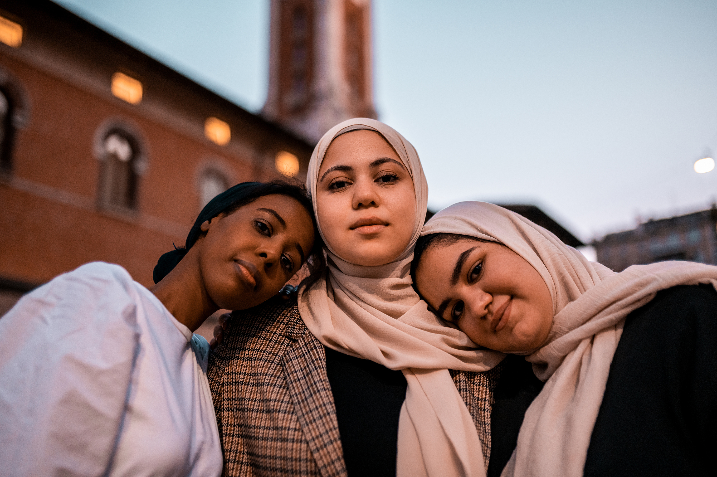
Spiritual Differences
As of 2016, 52% of all Australians identify as Christians (Australian Bureau of Statistics, 2016b).
Muslims at 2.6% and Buddhists at 2.4% follow (Australian Bureau of Statistics, 2016b).
Around 30% do not subscribe to a religion (Australian Bureau of Statistics, 2016b).
Recognise And Support Individual Differences

Slide 63
Some of the best practices in recognising differences
Ask the person.
Ask the family, carer or friends.
Read the person’s file.
Recognise And Support Individual Differences

Slide 64
1.1.2 Respecting Social, Cultural and Spiritual Differences
To respect is to provide an acceptable feeling or action to someone.
It is something that you show and give the person.
It is simply doing actions that will never hurt or harm the person.
On the next slide, you will find the best practices in respecting the three key differences.
Recognise And Support Individual Differences

Slide 65
Respecting Social Differences
Acknowledge the person’s preferences in social gatherings and events.
Do not belittle a person by their background.
Call the person by their preferred name and/or pronoun.
Recognise And Support Individual Differences

Slide 66
Respecting Cultural Differences
Avoid cultural taboos applicable to the person.
Follow basic courtesy according to the person’s culture.
Avoid stereotypes.
Recognise And Support Individual Differences

Slide 67
Respecting Spiritual Differences
Try to avoid discussing topics related to spirituality.
Provide the person with their own space for religious practices.
Consider banned items and actions like cultural taboos in some religions.
Recognise And Support Individual Differences

Slide 68
You should never make assumptions or judgements about someone’s individual differences.
Listen to the person and acknowledge their views and opinions.
In support work, individual differences must be considered.
Support workers do this by addressing the person’s beliefs, values and expectations.
Doing this ensures that person is comfortable and provided with a non-judgmental environment.
Recognise And Support Individual Differences

Slide 69
On Privacy, Confidentiality and Disclosure
Remember to respect the person’s privacy.
In order to do that, you must:
Maintain the confidentiality of any information shared with you
Only disclose information to authorised personnel
Consult your organisations’ policies and procedures when in doubt
Recognise And Support Individual Differences

Slide 70

1.2 Avoid Imposing Views and Support the Person’s Expression of Identity and Preferences

Slide 71
People by nature assess and judge the world around them.
It is what allows them to:
Make sense of the world
Identify risks and dangers
Gather information for decision-making
Recognise And Support Individual Differences

Slide 72

A person will follow their values and attitudes.
Values are what a person holds to be important.
Attitudes refer to how a person thinks and behaves towards someone or something.
Recognise And Support Individual Differences

Slide 73
People also assess and judge other people to determine a person’s identity and preferences.
Identity combines all the unique characteristics that make up a person.
Preferences refer to what a person likes when presented with different options.
To impose is to practise your own values and attitudes on others.
Imposing values and attitudes is normal in a healthy society yet can be problematic, when the imposer harms the other person.
Recognise And Support Individual Differences

Slide 74
Discrimination
It refers to acts that infringe upon the rights of others.
When deprived of rights, people may be in harm’s reach.
It may also include withholding privileges and opportunities.
Recognise And Support Individual Differences

Slide 75

Laws that help prevent discrimination from happening:
Australian Human Rights Commission Act 1986
Disability Discrimination Act 1992
Racial Discrimination Act 1975
Sex Discrimination Act 1984
Age Discrimination Act 2004
Recognise And Support Individual Differences

Slide 76
Community Values and Attitudes
Discrimination becomes persistent and harmful when many people do it.
A community can have the same negative values and attitudes over time which may result in myths and stereotypes.
Myths in the context of discrimination are about false relationships between two ideas.
Recognise And Support Individual Differences

Slide 77
In forming myths, a harmless idea gets associated with a harmful one.
Below are examples of myths that may persist and cause harm:
Harmless idea | Harmful idea | Myth
Education | Addiction | Only people with no formal education suffer from addiction.
Economic class | Entitlement | Being rich makes you immune to some laws.
Age | Low productivity | You become less productive as you age.
Age | Loneliness | You get lonelier as you grow older.
Recognise And Support Individual Differences

Slide 78
In forming myths, a harmless idea gets associated with a harmful one.
Below are examples of myths that may persist and cause harm:
Harmless idea | Harmful idea | Myth
Disability | Helplessness | People with disability need help all the time.
Disability | Low productivity | People with disability are not productive.
Liability | Discrimination | You are only liable for your actions if you commit intentional discrimination.
Recognise And Support Individual Differences

Slide 79
Stereotypes are general beliefs and attitudes towards a specific group of people.
These beliefs and attitudes are usually too simplistic and sometimes offensive.
Stereotypes and myths are closely related and sometimes used interchangeably.
Stereotypes are usually associated with sex, gender and race.
Recognise And Support Individual Differences

Slide 80
Common stereotypes include the following:
Some races are more superior to others.
Childcare is only a woman's responsibility.
Men are not and must never be emotional.
Jobs that need physical work are only for men.
Women lack rationality and are prone to influence.
Older people are wise. Their opinions are equal to the truth.
People with disability prefer the company of other people with disability.
Recognise And Support Individual Differences

Slide 81

Stopping Discrimination
Discrimination is a persistent problem that everyone must stop from doing.
It starts with the person and must extend to the community.
As a support worker, you must always avoid discrimination.
The next two sections will help you with this.
Recognise And Support Individual Differences

Slide 82
1.2.1 Avoiding Imposition of Own Values and Attitudes on Others
It is vital that you have a high level of self-awareness which means you recognise your personal values and attitudes.
Actions that can help you build up your self-awareness include:
Notice your reactions.
Acknowledge and identify your reactions to words, situations, or events.
Recognise And Support Individual Differences

Slide 83

Actions that can help you build up your self-awareness include:
Name your feelings.
Feelings can be anger, joy, disgust, admiration or others.
Reflect on your thoughts.
Take the time to unpack these feelings and understand what they mean to you.
Recognise And Support Individual Differences

Slide 84
Self-awareness is the key to avoiding imposing your own values and attitudes onto others.
You can avoid putting pressure on others to think and behave the same way you do.
This creates room for you to focus on supporting a person and gives them the space to express their own identity and preferences.
In that case, you can practise your duty of care.
Recognise And Support Individual Differences

Slide 85
1.2.2 Supporting the Person to Express Their Own Identity and Preferences
A person must be able to express their own identity and preference.
To express is to practise any beliefs, values, norms, or actions without discrimination.
As a support worker, you must learn to respect the person’s identity and preference as part of your duty of care.
In your role, the best way to support the person’s expression is to involve them in all processes.
Recognise And Support Individual Differences

Slide 86
Decisions about their care or other services coming from them may include:
Calling them by their preferred name
Asking permission before helping them
Listening to feedback about how they feel
Providing choices for their meals and drinks
Having a flexible routine in your day-to-day support tasks
Recognise And Support Individual Differences

Slide 87
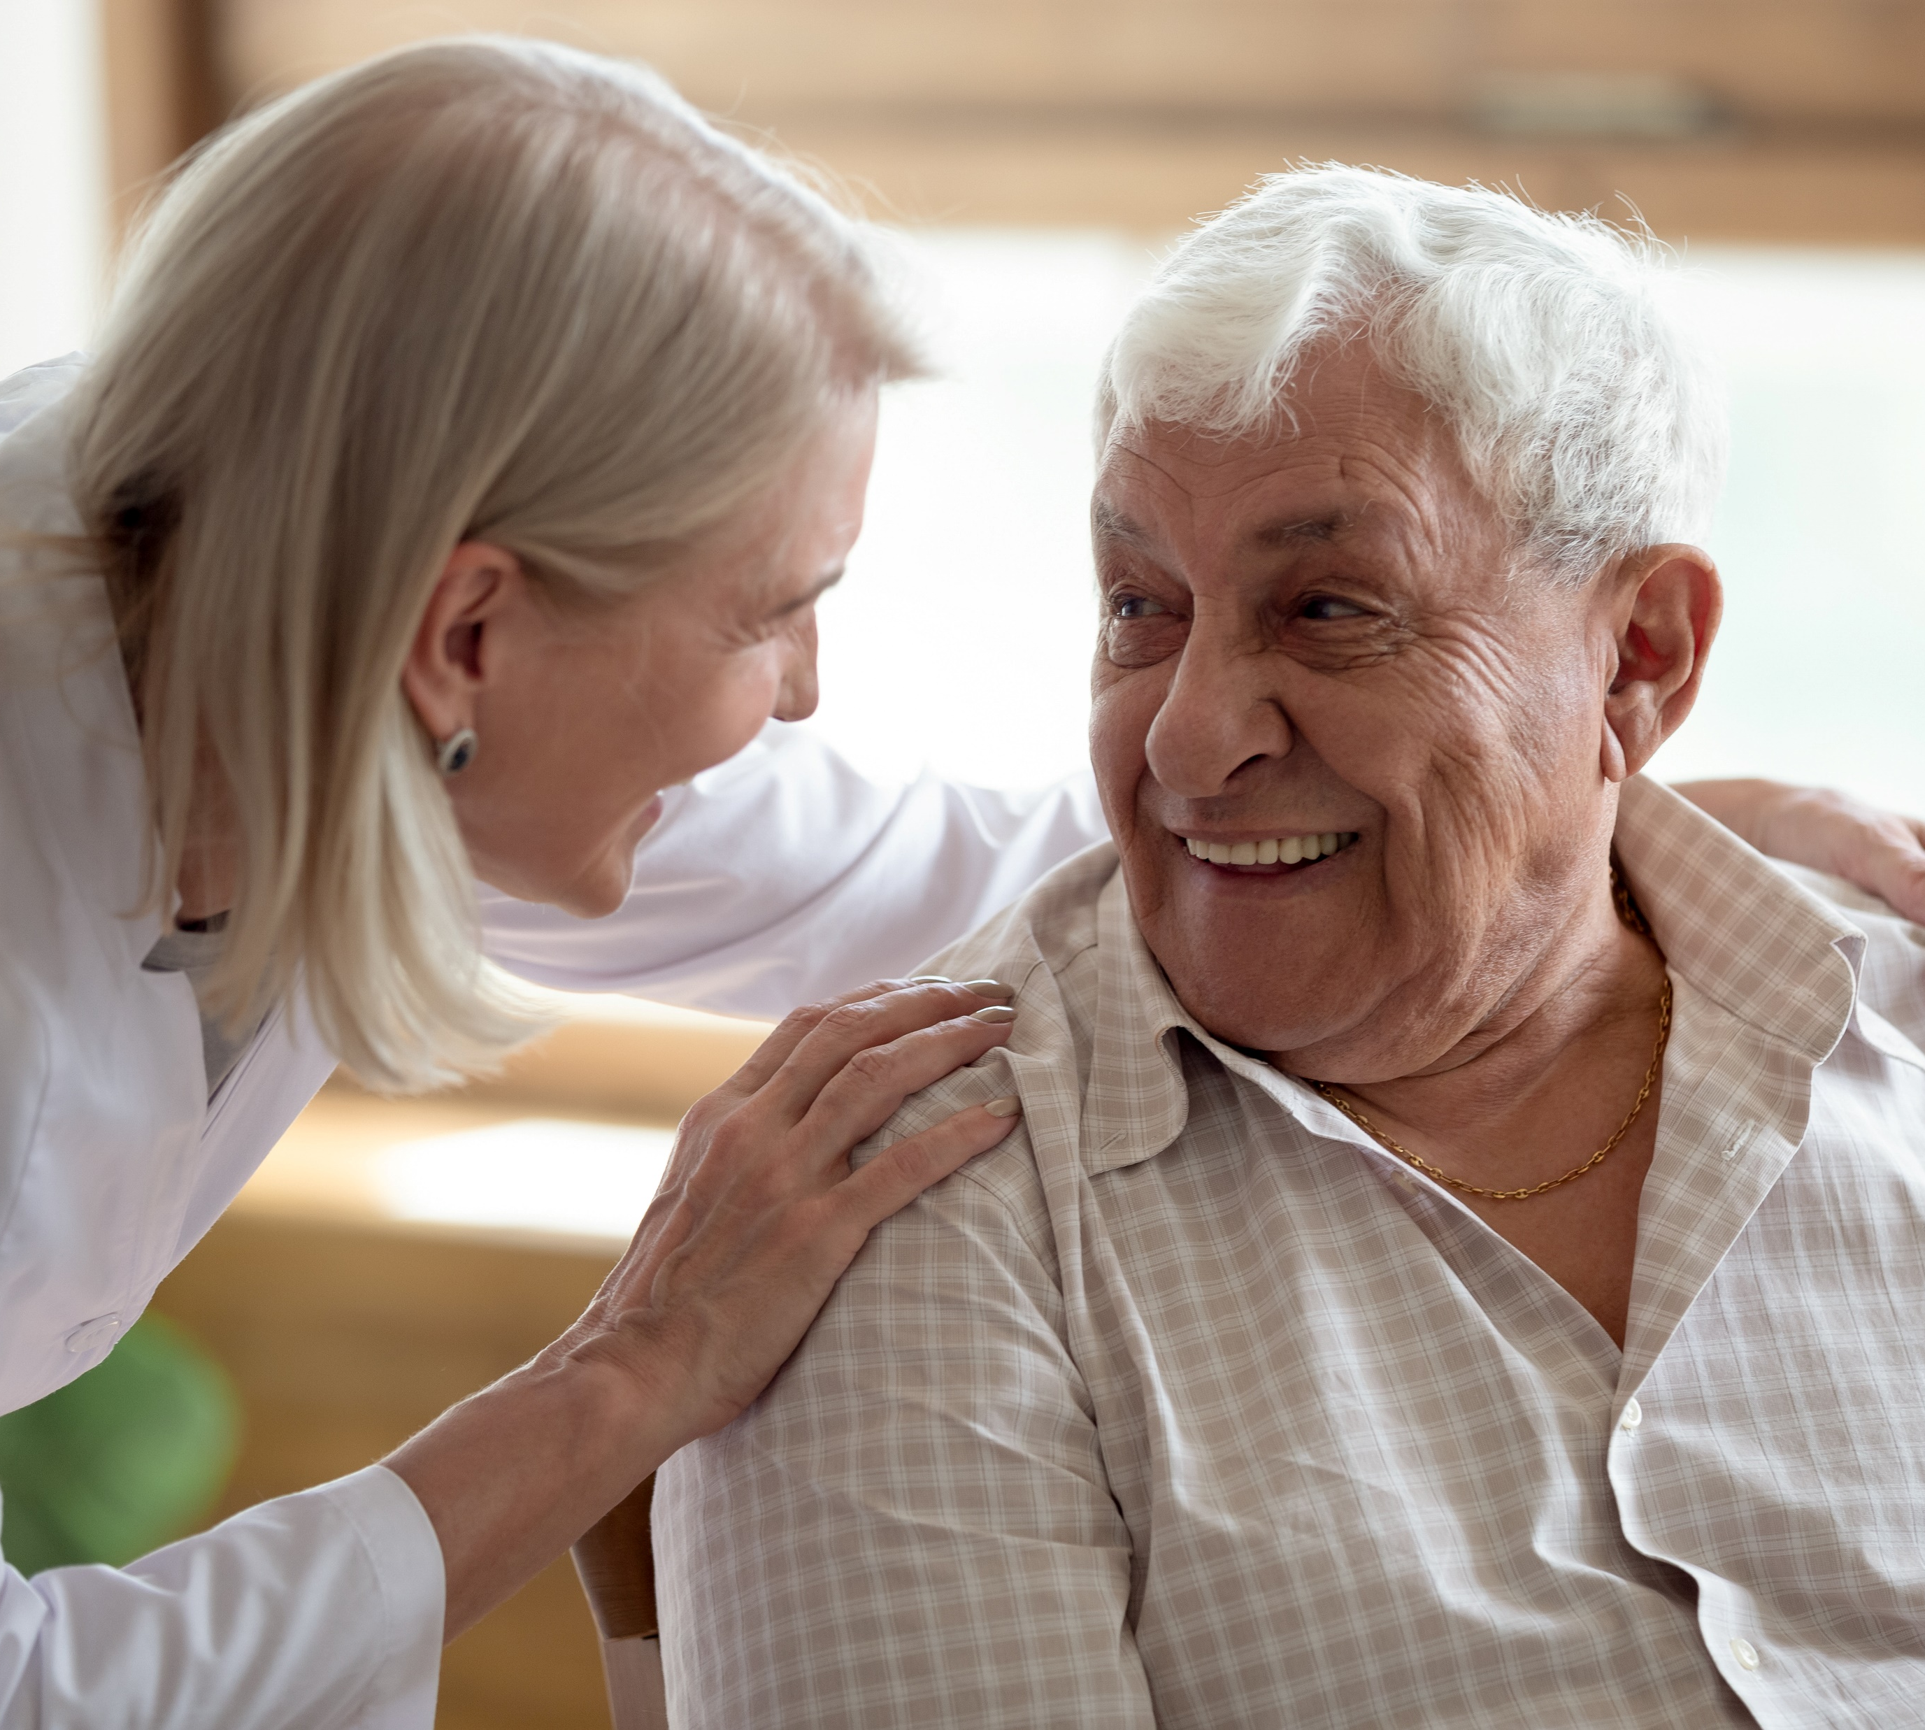
Decisions about their care or other services must come from them include:
Providing information so that a person can make an informed decision
Involving the person in daily decisions like what outfit they will wear that day
Enabling the person to maintain contact with friends and the local community.
Recognise And Support Individual Differences

Slide 88
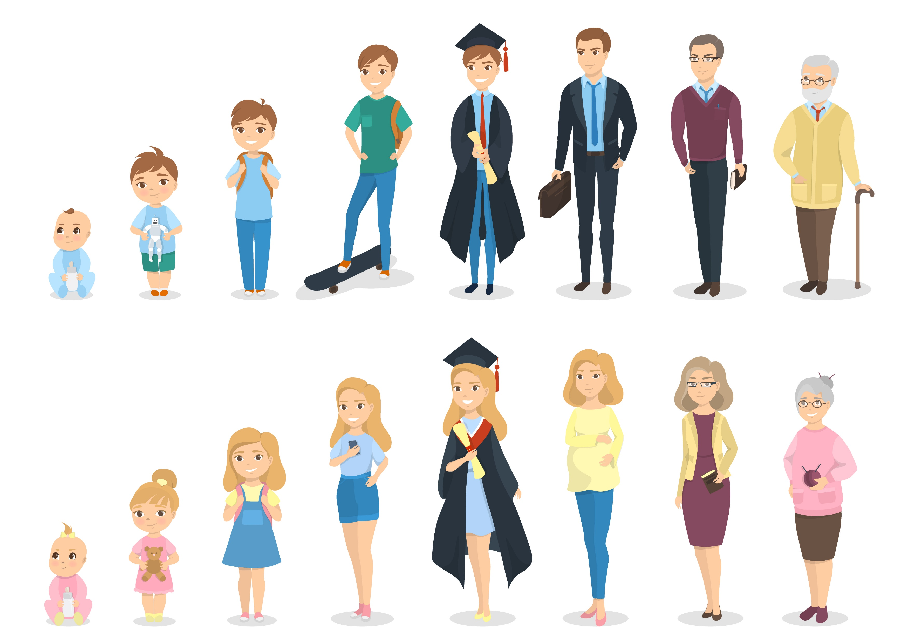
1.3 Consider the Individual Needs, Stage of Life, Development and Strengths for Support Activities

Slide 89
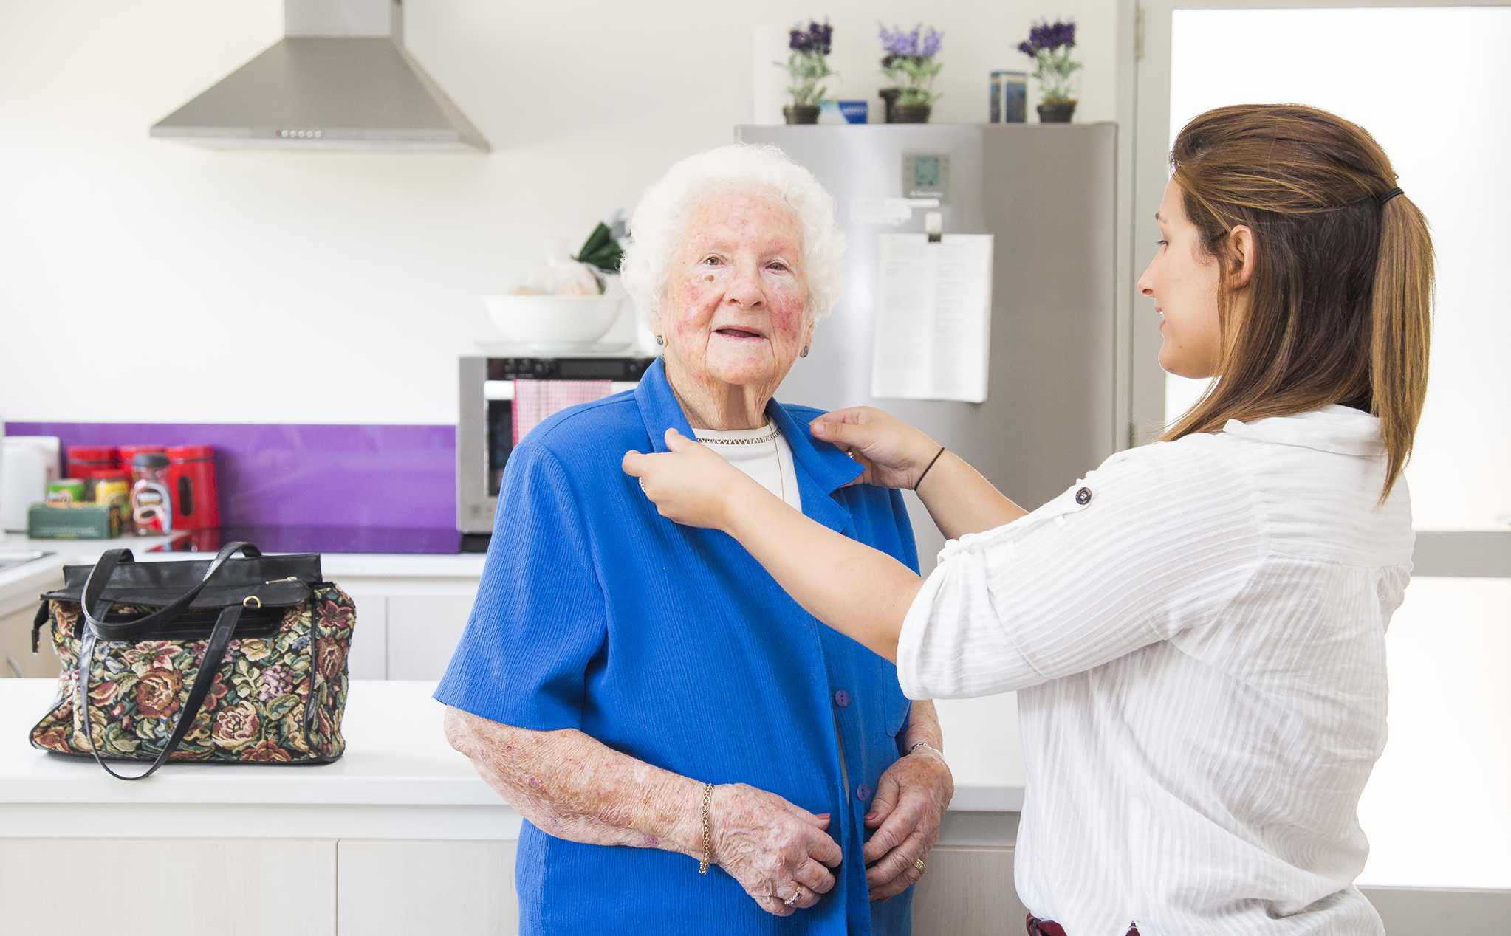
In supporting individuals, you can consider many factors, but you are also likely working with an individualised plan.
Therefore, you must:
Follow a person-centred approach that involves them from start to finish
Address the person’s needs, goals and preferences
Recognise And Support Individual Differences

Slide 90
In doing so, you may consider the following factors:
Individual needs of the person
Stage of life and development of the person
Strengths of the person
Recognise And Support Individual Differences

Slide 91
Individual Needs
It may refer to a person’s basic human needs to be safe, healthy and happy.
You can group these needs into the following groups:
Physical
Psychological
Spiritual
Cultural
Sexual
Recognise And Support Individual Differences

Slide 92
Stages of Life and Development
One way of understanding a person is to know what stage of life they are in.
Life stages can be categorised into the following:
Stage of Human Development | Description
Infancy | The child is completely dependent on others during the first stage of life
Recognise And Support Individual Differences

Slide 93
Life stages can be categorised into the following:
Stage of Human Development | Description
Early childhood | The child’s growing self-control is expressed through climbing, touching, exploring etc. They develop a general desire to do things for themselves.
School age | In school, the child begins to learn skills valued by society, and success or failure can have a lasting effect on their feelings of adequacy.
Recognise And Support Individual Differences

Slide 94
Life stages can be categorised into the following:
Stage of Human Development | Description
Adolescence | Mental and physical maturation brings with it new feelings, a new body and new attitudes.
Adulthood | The person strives to create or nurture things that will outlast them, generally through parenting or contributing positive changes that benefit other people.
Recognise And Support Individual Differences

Slide 95
Life stages can be categorised into the following:
Stage of Human Development | Description
Maturity | The person reflects on the life they have lived and either acquire a sense of fulfilment from a life well-lived or a sense of regret over a life misspent.
Recognise And Support Individual Differences

Slide 96
Each stage of life brings different experiences, needs and goals to a person.
Development also occurs in many aspects including:
The human body grows, matures, then declines as it ages
Intellectual, emotional and social capabilities generally mature with age
A person may lose the need to meet their sexual tendencies as they age
Some people take part in more spiritual activities as they reach older age
A person may move to different places with different cultures in their lifetime
Recognise And Support Individual Differences

Slide 97
Take note of the following information that may change or develop as a person ages while you work with them:
Age
Gender identity
Sexual orientation
Marital status
Home address
Family background
Economic power
Employment history
Recognise And Support Individual Differences

Slide 98
Take note of the following information that may change or develop as a person ages while you work with them:
Educational background
Mental health
Physical fitness
Eating habits and preferences
Language spoken
Style and presentation
Ethnicity and cultural background
Recognise And Support Individual Differences

Slide 99

You must respect the person’s privacy and uphold confidentiality at all times.
Stick with your organisation’s policies and procedures when handling a person’s information.
Recognise And Support Individual Differences

Slide 100
Strengths
In support work, you must also incorporate strategies that develop the person strengths.
A strengths-based approach:
Is another method often incorporated in individualised plans
Involves collaboration between you and the person
Is effective because it increases the person’s participation
Because of this, they gain some sense of control in the service.
Recognise And Support Individual Differences

Slide 101
Generally, you can follow the steps below for a strengths-based approach:
Assess and understand the person’s capabilities and skills.
Consider these strengths in the person’s individualised plan.
Incorporate activities and methods that take advantage of the person’s strengths.
Recognise And Support Individual Differences

Slide 102
The important thing to remember when working with an individualised plan that someone has prepared is to undergo regular checking.
Adjustments are possible as a person’s needs change.
It changes depending on their condition.
You must be familiar with their capabilities and skills.
Recognise And Support Individual Differences

Slide 103
The following information can help identify the person’s strengths:
Take note to not discriminate against a person when assessing their information and that all information gathered will be used for supporting the person.
Hobbies
Favourites
Social circle
Job role
Health
Recognise And Support Individual Differences

Slide 104
The following information can help identify the person’s strengths:
Take note to not discriminate against a person when assessing their information and that all information gathered will be used for supporting the person.
Cultural background
Educational background
Physical activities
Community background
Recognise And Support Individual Differences

Slide 105
Support Activities
You have established the importance of the following factors when supporting a person:
Individual needs of the person
Stage of life and development of the person
Strengths of the person
Always remember that these factors are not considered separately.
Recognise And Support Individual Differences

Slide 106
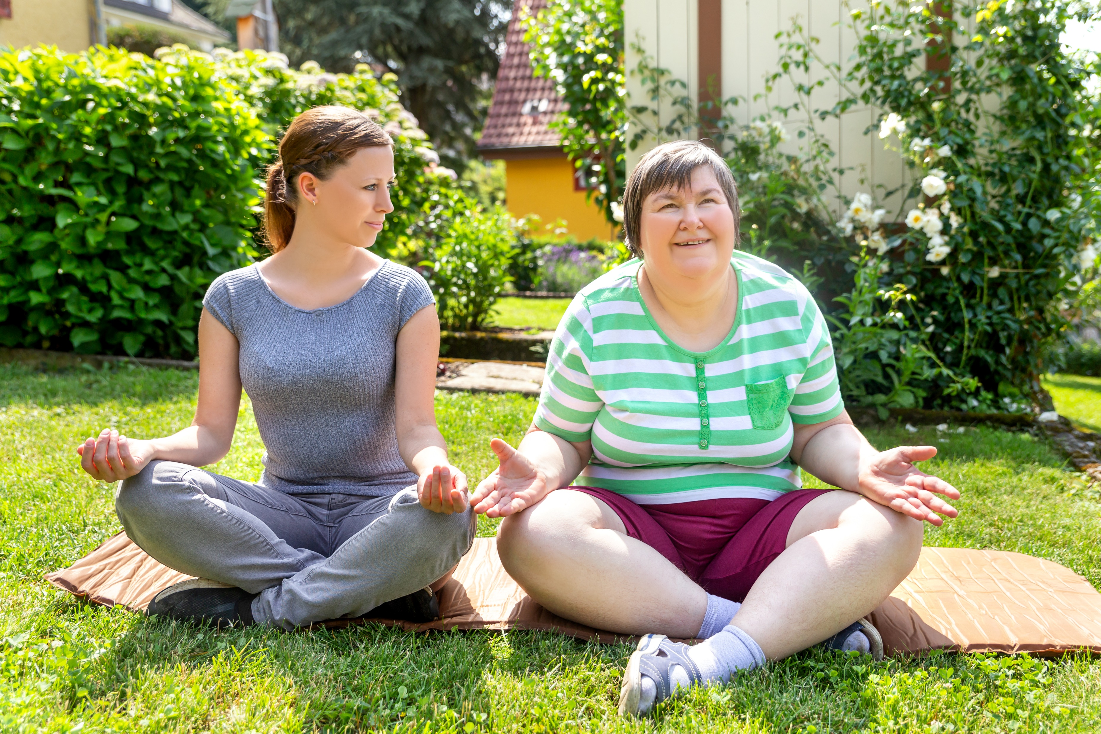
It is important for these factors to work together to:
Give the person the best support activities that address their needs
Make the support activities more compatible with the person’s condition
Recognise And Support Individual Differences

Slide 107
The support activities that you will join will depend on your job role and specialisation.
Therefore/Because of this:
You should be familiar with the relevant policies and procedures
You should never forget to recognise and respect any differences that you may encounter
Recognise And Support Individual Differences

Slide 108
Support activities and factors that can affect the delivery:
Facilitating speech therapy sessions for an eight-year-old individual
Given their age, you must coordinate closely with the parents or carers.
You must consider their school schedule for the therapy sessions.
The therapist must be someone capable of working with children.
Recognise And Support Individual Differences

Slide 109
Support activities and factors that can affect the delivery:
Food services for a 40-year-old who is recovering from an accident
Make sure to ask the person for any personal, cultural or religious preferences.
You must check for any dietary restrictions based on their health condition.
As the person recovers, they may start to help in some cooking tasks.
Recognise And Support Individual Differences

Slide 110
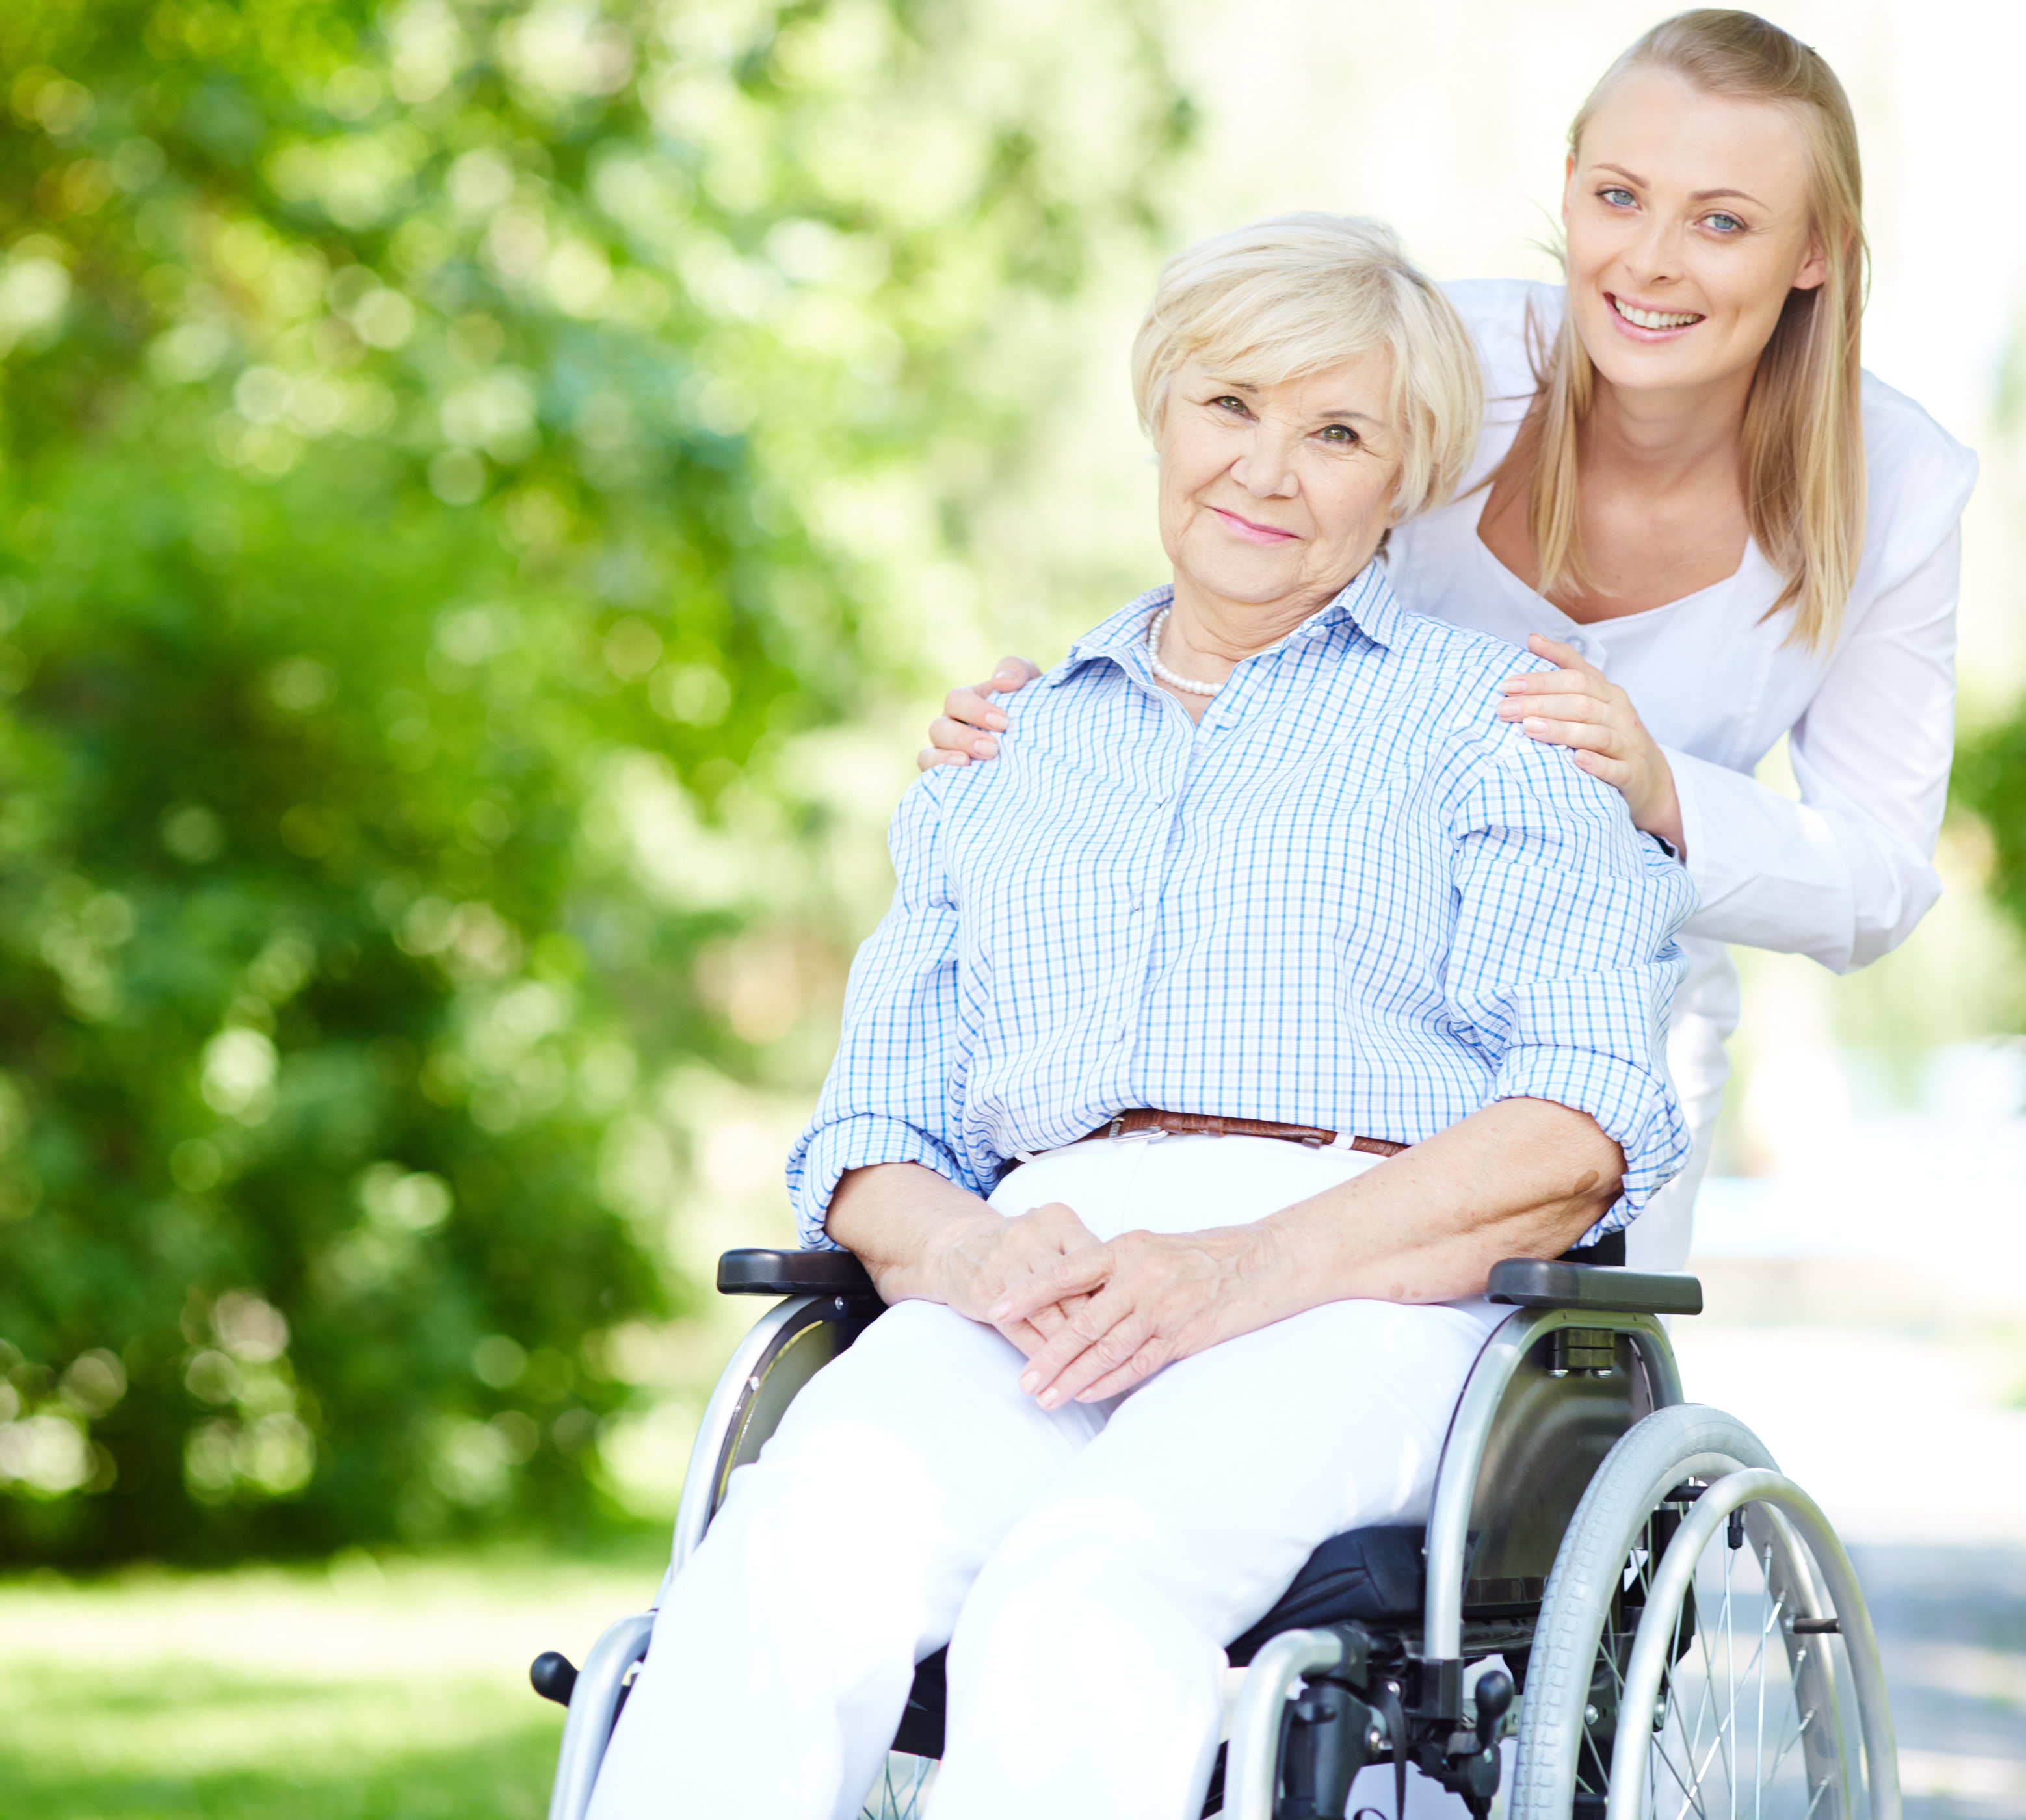
Support activities and factors that can affect the delivery:
Care work for a 70-year-old in an aged care facility
Be familiar with the person’s health condition and general wellbeing.
Coordinate closely with their families and assigned health professionals.
Make sure to ask permission before helping them in any way.
Recognise And Support Individual Differences

Slide 111

1.4 Recognise, Respect and Accommodate the Expression of Identity and Sexuality According to Maturity

Slide 112
In the current society, identity and sexuality are important considerations. These elements must be recognised, respected and accommodated.
The person's age and stage of life that define an individual's maturity level.
Sex and sexuality have always been sensitive topics, and for many people, they remain so. Some individuals are uncomfortable discussing it.
It is critical to be aware of this.
You must respect the individual's point of view.
Recognise And Support Individual Differences

Slide 113
Expressions of Identity and Sexuality
Identity is the collection of characteristics that define a person or organisation.
The following is a founding principle for understanding what forms a personal identity:
Age
Biological Sex
Sexuality
Diet
Hobbies
Body
Recognise And Support Individual Differences

Slide 114
Expressions of Identity and Sexuality
Identity is the collection of characteristics that define a person or organisation.
The following is a founding principle for understanding what forms a personal identity:
Religion
Language/s
Cultural background
Politics
Nationality
Group affiliations
Recognise And Support Individual Differences

Slide 115
Biological sex is the person’s conventional identity based on their reproductive role.
The conventional biological sexes are referred to as:
Male
Female
The word ‘sex’ is often used to refer to biological sex.
This can be confusing with sexual intercourse, which is also shortened to ‘sex’.
Context is important when discussing all this.
Recognise And Support Individual Differences

Slide 116
There has been a growth in public awareness and understanding of sexuality in recent years.
Sexuality is the person’s views and attitudes towards sex and physical intimacy.
Sexual identity is how a person sees themself according to their sexuality.
Sexual expression is how a person behaves according to their sexuality.
Recognise And Support Individual Differences

Slide 117

Always remember that identity is fundamentally personal.
As a result, certain people may not fit into the arbitrary categories of sexual identification.
Some people may also be aware of their sexual orientation.
They may, however, adopt a different sexual expression.
This is the situation when they experience discrimination.
Recognise And Support Individual Differences

Slide 118

Below shows the many recognised sexual identities:
Heterosexual – a person attracted to the opposite biological sex
Asexual – when a person has low to no sexual attraction or activities with anyone
Recognise And Support Individual Differences

Slide 119
Below shows the many recognised sexual identities:
LGBTQI – an acronym for a variety of sexual identities.
Lesbian – a biological woman who identifies as a woman and is attracted to someone who identifies as a woman
Gay – a biological man who identifies as a man and is attracted to someone who identifies as a man
Bisexual – a person attracted to both biological sexes
Recognise And Support Individual Differences

Slide 120
Below shows the many recognised sexual identities:
LGBTQI – an acronym for a variety of sexual identities.
Transgender – a person who identifies with their opposite biological sex
Queer – a person who does not follow the conventional sexuality
Intersex – a person with the condition that makes it difficult to identify their biological sex
Recognise And Support Individual Differences

Slide 121
Issues Surrounding Sexuality and Sexual Expression
There are various issues on sexuality and sexual expression.
Foremost of which is the different views and the resulting possible discrimination.
As a support worker, you need to learn more about it.
Also, always refer to your organisation’s policies and procedures on these topics.
Recognise And Support Individual Differences

Slide 122

Sexuality and sexual expression are closely linked.
Sexuality refers to a person's beliefs and attitudes toward sex.
Sexual expression refers to a person's behaviour that is influenced by their sexuality.
Recognise And Support Individual Differences

Slide 123
Issues surrounding sexuality and sexual expression are also related.
A sexuality issue can have an impact on sexual expression.
Issues that impede sexual expression may affect a person's sexuality.
Recognise And Support Individual Differences

Slide 124
Issues surrounding sexuality can include:
Body image after undergoing
Depression, leading to loss of interest in sex
Unhealthy sexual obsessions
Cultural differences
Social conditioning
Discrimination
Recognise And Support Individual Differences

Slide 125

Issues surrounding sexual expression can include:
Having no partner
Loss of the sensation of ejaculation
Reduced mobility due to arthritis or stroke
Reduced penile rigidity and vaginal lubrication
Drugs that can cause impotence or lack of libido
Physical barriers (such as catheters or pessaries)
Recognise And Support Individual Differences

Slide 126
Recognising, Respecting and Accommodating the Person
When dealing with identity and sexuality, it is vital to recognise, respect, and accommodate.
Recognising a person's sexuality begins with a simple conversation with them.
Being approachable will benefit both you and people of particular sexual identities who often feel discouraged to be social.
Recognise And Support Individual Differences

Slide 127
One way to show respect is asking the person the appropriate questions that do not convey any form of discrimination.
The following are examples of questions in appropriate form:
Do you have a partner or a spouse?
Are you dating or seeing anyone now?
Are you married, or have you been married?
Would you like to go on a date with someone?
Recognise And Support Individual Differences

Slide 128

To accommodate means:
To adjust for the person
A skill for a support worker
All people have the right to have their sexual needs met in privacy and with dignity.
Recognise And Support Individual Differences

Slide 129
In your role, you can accommodate a person’s sexuality and needs by:
Supporting how they dress
Facilitating their privacy when required
Supporting their preferred social activities
Supporting who they would like to develop healthy relationships with
Recognise And Support Individual Differences

Slide 130
Support and professional services that can help with sexual needs include:
Private organisations that provide counselling and education for people with some form of disability
Family planning centres with educational resources and books about sexuality
Family planning centres that conduct sexual health promotion activities and offer clinical services
Workplace documentation and management detailing services that relate to your industry sector
Recognise And Support Individual Differences

Slide 131

1.5 Promote and Facilitate Participation in Activities That Reflect the Person’s Individual Needs

Slide 132
Activities That Reflect the Person’s Individual Needs
In your role, you will support the person on activities related to the first four needs (physical, social, cultural, and spiritual) as listed below:
Physical Needs
Eating and drinking
Sleeping
Washing
Exercising
Recognise And Support Individual Differences

Slide 133
Activities related to the first four needs:
Social Needs
Dating
Group sports
Hobby classes
Family gatherings
Meeting up with friends
Recognise And Support Individual Differences

Slide 134
Activities related to the first four needs:
Cultural Needs
Rituals and rites
Community events
Cultural celebrations
Learning new languages
Meeting other people of the same ethnic origin
Recognise And Support Individual Differences

Slide 135
Activities related to the first four needs:
Spiritual Needs
Attending places of worship
Practising spiritual activities
Praying and acts of devotion
Celebrating holy days and occasions
Eating or not eating certain foods at certain times
Recognise And Support Individual Differences

Slide 136
Promoting Opportunities for Participation
To promote is to encourage the person to join or partake that generally means:
You present an upbeat and helpful attitude
You talk about the benefits of the opportunity
You acknowledge every effort the person makes
You avoid highlighting mistakes or inadequacies
You discourage their negative thoughts and foster their positive ones
Recognise And Support Individual Differences

Slide 137

Some of the best practices that promote opportunities for participation in activities that address the person’s individual needs:
Physical Needs
Talk about the benefits of a healthy diet.
Motivate the person to follow a more active lifestyle.
Advocate for professional help if the person needs it.
Recognise And Support Individual Differences

Slide 138
Best practices that promote opportunities for participation in activities that address the person’s individual needs:
Social Needs
Make yourself available for a casual conversation.
Encourage them to continue or start worthwhile hobbies.
Ask which family or friends they would like to see this week.
Recognise And Support Individual Differences

Slide 139
Best practices that promote opportunities for participation in activities that address the person’s individual needs:
Cultural Needs
Provide the listening ear if they feel discriminated against and need to talk.
If appropriate, engage in conversations that highlight their culture.
If appropriate, encourage the person to practice cultural activities.
Recognise And Support Individual Differences

Slide 140
Best practices that promote opportunities for participation in activities that address the person’s individual needs:
Spiritual Needs
Avoid talking about religion if both of you are uncomfortable with the subject.
Check for holy days and ask how they would like to celebrate these.
Avoid making comments that may be misinterpreted as offensive.
Recognise And Support Individual Differences

Slide 141
Facilitating Opportunities for Participation
To facilitate is to help a person by making things easier for them and generally means:
You help the person set up their goals and desires
You assist the person in preparing pre-requirements such as:
Transportation
Documents
Permits
Recognise And Support Individual Differences

Slide 142
To facilitate is to help a person by making things easier for them that generally means:
You provide for the requirements during the opportunity, such as:
Guardianship
Preparation
Equipment
Company
Recognise And Support Individual Differences

Slide 143
Promotion and facilitation ultimately imply supporting the individual.
These two are critical when it comes to providing support to a person.
They guarantee that the person addresses their needs.
These take care of their wellbeing.
Doing the activities on their own encourages independence.
Recognise And Support Individual Differences

Slide 144
The individualised plan:
Will most likely comprise all the activities that you will support
Must then be understood as soon as possible
When doing so, always remember to refer to your organisation’s policies and procedures.
Recognise And Support Individual Differences

Slide 145

What have we learnt?
In this part of the session, we have covered:
Recognise and support individual differences
Promote independence
Support physical wellbeing
Support social, emotional and psychological wellbeing

Slide 146
End of Chapter 1

